Slide 1
CSS Colors

Slide 2
Keywords
h1 {
color: black;
}

Slide 3
RGB Model
h1 {
color: rgb([0 to 255], [0 to 255], [0 to 255]);
}

Slide 4
RGBA Model (with alpha)
h1 {
color: rgba([0 to 255], [0 to 255], [0 to 255], [0 to 1]);
}

Slide 5
Hexadecimal Notation (0 to 9, A to F)
h1 {
color: #00ffff;
}
h1 {
color: #0ff;
}

Slide 6
Hexadecimal Notation with Alpha (00 to FF)
h1 {
color: #00ffff80; /* 80 means 50% opacity */
}

Slide 7
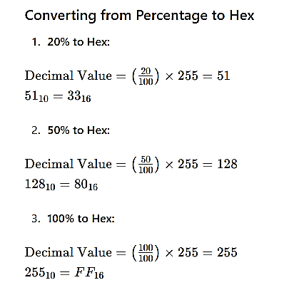
Conversion Samples

